Slide 1


On Stopwords, Filtering and Data Sparsity for Sentiment Analysis of Twitter
Hassan Saif, Miriam Fernandez, Yulan He and Harith Alani
Knowledge Media Institute, The Open University,
Milton Keynes, United Kingdom
The 9th edition of the Language Resources and Evaluation Conference, Reykjavik, Iceland
Notes:
Hi everyone,
My name is Hassan Saif, a PhD student KMI in UK.
Today I’m gonna present our work on Evaluation datasets for Twitter Sentiment Analysis.. Surveying the pre-existed datasets and proposing a new dataset. the STS-Gold.

Slide 2
Outline
Sentiment Analysis
Twitter
Stopwords Removal Methods
Comparative Study
Conclusion
Notes:
I’m gonna start with some basic definitions about the sentiment analysis task on Twitter. then talking about the motivation behind our study.
Next I will give a quick overview about the existed evaluation datasets and preseting our new dataset the STS-Gold.
Afterwards I’m gonna talk talk about the our results obtained from a comparative study we conducted on the these datasets.
Our study is three main parts: in the first part I’m gonna give an overview of some of the most widely used evaluation datasets for Twitter sentiment analysis, pointing out their limitation
In the second part I’m gonna present our new gold standard dataset which overcome some of the limitations of the pre-existed datasets
The third part is about a comparative study we performed on the all the datasets in terms of 4 different aspects.

Slide 3
Sentiment Analysis
“Sentiment analysis is the task of identifying positive and negative opinions, emotions and evaluations in text”
The main dish was delicious
It is a Syrian dish
The main dish was salty and horrible
Opinion
Fact
Opinion

Slide 4

Conventional Text
Rich
Formal Language {Well Structured Sentences}
Domain Specific
Notes:
Early work on Sentiment analysis focused mainly on extracting sentiment from conventional text such as movie reviews, blogs, news articles and open forums
Textual content in these type of media sources is linguistically rich, consists of well structured and formal sentences, and discusses specific topic or domain (e.g., movie reviews)

Slide 5
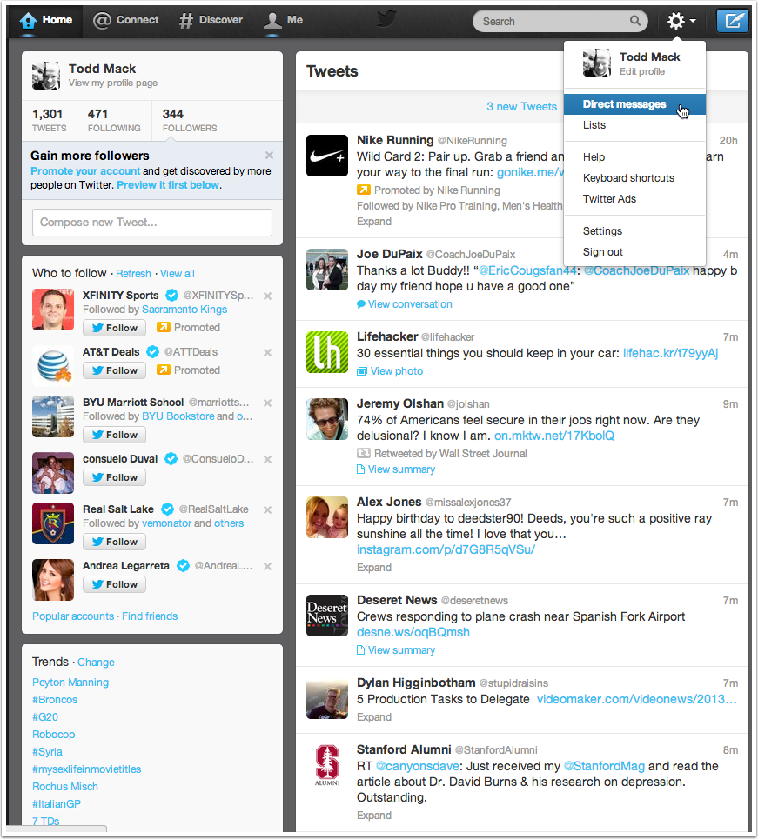
Twitter Data
Short (140-Chars)
Noisy {gr8, lol, :), :P}
Open Environment
Notes:
However, with the emergent of social media networks and microblogging platforms, especially Twitter, research interests shifted to analyzing and extracting sentiment from theses new sources.
Nevertheless, One of the key challenges that Twitter sentiment analysis methods have to confront is the noisy nature of Twitter generated data. Twitter allows only for 140 characters in each post, which influences the use of abbreviations, irregular expressions and infrequent words.
This phenomena increases the level of data sparsity, affecting the performance of Twitter sentiment classifiers

Slide 6
Stopwords Removal
Stopwords, by definition, are meaningless words that have low discrimination power.
Notes:
A well known method to reduce the noise of textual data is the removal of stopwords. This method is based on the idea that discarding non-discriminative words reduces the feature space of the classifiers and helps them to produce more accurate results

Slide 7
Stopwords Removal in Twitter Sentiment Analysis
YES
NO
Kouloumpis et al. 2011
Pak & Paroubek, 2010
Asiaee et al., 2012
Bollen et al., 2011
Bifet and Frank, 2010
Speriosu et al., 2011
Zhang & Yuan, 2013
Gokulakrishnan et al 2012
Saif et al., 2012
Hu et al., 2013
Camara et al., 2013
Removing
Stopwords
is USEFUL
Notes:
This pre-processing method, widely used in the literature of document classification and retrieval, has been applied to Twitter in the context of sentiment analysis obtaining contradictory results.
While some works support their removal (RED Box), others claim that stopwords in- deed carry sentiment information and removing them harms the performance of Twitter sentiment classifiers

Slide 8
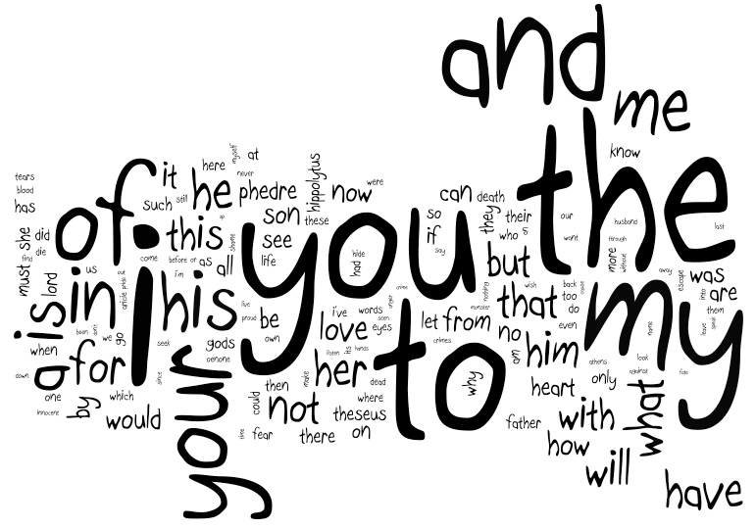
Classic Stopword Lists
Precompiled
Very popular
Outdated
Domain-Independent
Notes:
In addition, most of the works that have applied stopword removal for Twitter sentiment classification use pre-compiled stopwords lists, such as the Van stoplist
However, these stoplists have been criticized for:
being outdated (a phenomena that may affect specially Twitter data, where new information and terms are continuously emerging)
(ii) for not accounting for the specificities of the domain under analysis since non-discriminative words in some domain or corpus may have discriminative power in different domain.

Slide 9
Automatic Stopwords Generation Methods
Unsupervised Methods
Term Frequency
Term-based Random Sampling
Supervised
Term Entropy Measures
Maximum Likelihood Estimation
Notes:
Aiming to solve these limitations several approaches have emerged in the areas of document retrieval and classification that aim to dynamically build stopword lists from the corpus under analysis.
These approaches measure the discriminative power of terms by using different methods including
Unsupervised methods such as those based on the terms’ frequencies or
Supervised methods such as term entropy measures and Maximum Likelihood Estimation

Slide 10
Stopwords Removal for Twitter Sentiment Analysis
Analysis Study
Notes:
In our work, we studied the effect of different stopword removal methods for polarity classification of tweets and whether removing stopwords affects the performance of Twitter sentiment classifiers.

Slide 11
Datasets
Stopword Analysis Set-Up (1)
Notes:
To this end, we use six Twitter datasets obtained from the literature of Twitter sentiment classification.
As can be noted, these datasets have different size and different number of positive and negative tweets.

Slide 12
Stopwords Removal Methods
Stopword Analysis Set-Up (2)
The Baseline Method
(non removal of stopwords)
The Classic Method
This method is based on removing stopwords obtained from pre-compiled lists
Van Stoplist
Notes:
The Baseline method for this analysis is the non removal of stopwords.
We also assess the influence of six different stopword removal methods using six stopwords removal methods including:
The Classic Method: which is based on removing stopwords obtained from pre-compiled lists. In our analysis we use the classic Van stoplist

Slide 13
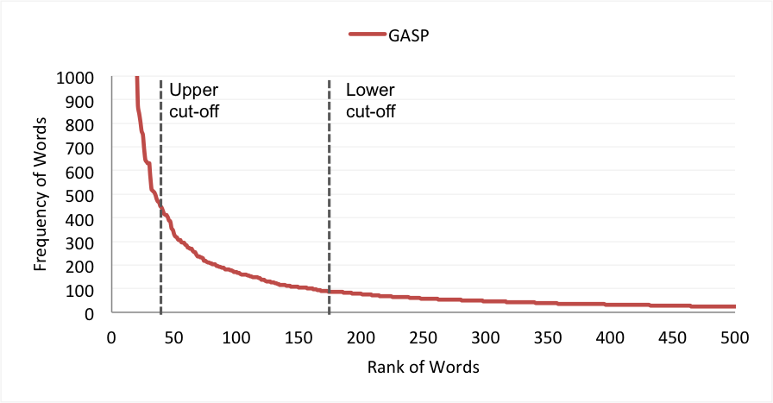
Stopwords Removal Methods
Stopword Analysis Set-Up (3)
Methods based on Zipf’s Law
TF-High Method
Removing most frequent
TF1 Method
Removing singleton words (i.e., words that occur once in tweets)
IDF Method
Removing words with low inverse document frequency (IDF)
Notes:
In addition to the classic Stoplist, we use three stopword generation methods inspired by Zipf’s law including: removing most frequent words (TF-High) and removing words that occur once, i.e. singleton words (TF1). We also consider re- moving words with low inverse document frequency (IDF).

Slide 14
Stopwords Removal Methods
Stopword Analysis Set-Up (4)
Term-based Random Sampling (TBRS)
The Mutual Information Method (MI)
Notes:
4- Term-based Random Sampling :
This method works by iterating over separate chunks of data ran- domly selected. It then ranks terms in each chunk based on their informativeness values using the Kullback-Leibler divergence measure
5- The Mutual Information Method:
The mutual information method (MI) is a supervised method that works by computing the mutual information between a given term and a document class (e.g., positive, negative), providing an indication of how much in- formation the term can tell about a given class. Low mutual information suggests that the term has low discrimination power and hence it should be easily removed.

Slide 15
Twitter Sentiment Classifiers
Stopword Analysis Set-Up (5)
Two Supervised Classifiers:
Maximum Entropy (MaxEnt)
Naïve Bayes (NB)
Measure the performance in Accuracy and F1 measure
10 fold cross validation
Notes:
To assess the effect of stopwords in sentiment classification we use two of the most popular supervised classifiers used in the literature of sentiment analysis, Maximum Entropy (MaxEnt) and Naive Bayes (NB) from Mallet.
We report the performance of both classifiers in accuracy and aver- age F-measure using a 10-fold cross validation. Also, note that we use unigram features to train both classifiers in our experiments.

Slide 16
Assess the impact of removing stopwords by observing fluctuations on:
Experimental Results
Classification Performance
Feature space
Data Sparsity
Notes:
We assess the impact of removing stopwords by observing fluctuations (increases and decreases) on three different as- pects of the sentiment classification task:
the classification performance, measured in terms of accuracy and F-masure, the size of the classifier’s feature space and the level of data sparsity.
Our baseline for comparison is not removing stopwords.

Slide 17
1. Classification Performance
Experimental Results (1)
Accuracy
F-Measure
The baseline classification performance in Accuracy and F-measure of MaxEnt and NB classifiers across all datasets
Notes:
The first aspect that we study is how removing stopwords affects the classification performance
This figure shows the baseline classification performance in accuracy (a) and F-measure (b) for the MaxEnt and NB classifiers across all the datasets.
As we can see, when no stopwords are removed, the MaxEnt classifier always outperforms the NB classifier in accuracy and F1 measure on all datasets.

Slide 18
1. Classification Performance
Experimental Results (2)
Accuracy
F-Measure
Average Accuracy and F-measure of MaxEnt and NB classifiers using different stoplists
Notes:
This figure shows the average performances in accuracy and F-measure obtained from the MaxEnt and NB classifiers by using the six stopword removal methods on all datasets
- Here we notice a significant loss in accuracy and in F-measure is encountered when using the IDF stoplist, while the highest performance is always obtained when using the MI stoplist.
Also, using the classic stoplist gives lower performance than the baseline with an average loss of 1.04% and 1.24% in accuracy and F-measure respectively
On the contrary, removing singleton words (the TF1 stoplist) improves the accuracy by 1.15% and F-measure by 2.65% compared to the classic stoplist.
We also notice that the TF1 stoplist gives slightly lower accuracy and F-measure than the MI stoplist respectively. Nonetheless, generating TF1 stoplists is much simpler than generating the MI ones in the sense that the former, as opposed to the latter, does not required any labelled data.
Finally, it seems that NB is more sensitive to removing stopwords than MaxEnt. NB faces more dramatic changes in accuracy than MaxEnt across the different stoplists.

Slide 19
2. Feature Space
Experimental Results (3)
Reduction rate on the feature space of the various stoplists
The number of singleton words to the number non singleton words in all datasets
Notes:
The second aspect we study is the average reduction rate on the classifier’s feature space caused by each of the studied stopword removal methods
- As we can see, Removing singleton words reduces the feature space substantially by 65.24%. MI comes next with a reduction rate of 19.34%. On the other hand, removing the most frequent words (TF-High) has no actual effect on the feature space. All other stoplists reduces the number of features by less than 12%.
- From the figure on the right, we can observe that singleton words constitute two-thirds of the vocabulary size of all datasets. In other words, the ratio of singleton words to non singleton words is two to one for all datasets. This two-to-one ratio explains the large reduction rate in the feature space when removing singleton words.

Slide 20
3. Data Sparsity
Experimental Results (4)
Stoplist impact on the sparsity degree of all datasets
Notes:
The third aspect we study is the reduction on the data sparseness caused by our 6 stopwords removal methods on all datasets.
Previous work on Sentiment analysis showed that Twitter Twitter data are sparser than other types of data (e.g., movie review data) due to the large number of infrequent words present within tweets. Therefore, an important effect of a stoplist for Twitter sentiment analysis is to help in reducing the sparsity degree of the data.
Our analysis showed that our Twitter datasets are very sparse indeed, where the average sparsity degree of the baseline is 0.997.
Compared to the baseline, using the TF1 method lowers the sparsity degree on all datasets by 0.37% on average. On the other hand, the effect of the TBRS stoplists is barely noticeable
Also All other stopword removal methods in- crease the sparsity effect with different degrees, including the classic, TF-High, IDF and MI.

Slide 21
The Ideal Stoplist (1)
The ideal stopword removal method is the one which:
Helps maintaining a high classification performance,
Leads to shrinking the classifier’s feature space
Reduces the data sparseness
Has low runtime and storage complexity
Has minimal human supervision
Notes:
After our evaluation, the question remains – What is the best or the ideal stopword method for Sentiment analysis on Twitter?
Broadly speaking, the ideal stopword removal method is the one which helps maintaining a high classification performance, leads to shrinking the classifier’s feature space and effectively reducing the data sparseness. Moreover, since Twitter operates in streaming fashion (i.e., millions of tweets are generated, sent and discarded instantly), the ideal stoplist method is required to have low runtime and storage complexity and to cope with the continuous shift in the sentiment class distribution in tweets. Lastly and most importantly, the human supervision factor (e.g., threshold setup, data annotation, manual validation, etc.) in the method’s workflow should be minimal.

Slide 22
Overall Analysis Results
The Ideal Stoplist (2)
Average accuracy, F1, reduction rate on feature space and data sparsity of the six stoplist methods. Positive sparsity values refer to an increase in the sparsity degree while negative values refer to a decrease in the sparsity degree.
Notes:
- This table shows the average performances of the evaluated stoplist methods in terms of the sentiment classification accuracy and F-measure, reduction on the feature space and the data sparseness, and the type of the human supervision required.
- According to these results, the MI and the TF1 methods show very competitive performances comparing to other methods; the MI method comes first in accuracy and F1 measure while the TF1 method outperform all other methods in the amount of reduction on feature space and data sparseness.
looking at the human supervision factor, the TF1 method seems a simpler and more effective choice than the MI method. Firstly, because the notion behind TF1 is rather simple - “stopwords are those which occur once in tweets”, and hence, the computational complexity of generating TF1 stoplists is generally low. Secondly, the TF1 method is fully unsupervised while the MI method needs two major human supervisions including: (i) deciding on the size of the generated stoplists, which is usually done empirically and (ii) manually annotating tweet messages with their sentiment class label in order to calculate the informativeness values of terms as described in Equation 2.

Slide 23
Conclusion
We studied how six different stopword removal methods affect the sentiment polarity classification on Twitter.
The use of pre-compiled (classic) Stoplist has a negative impact on the classification performance.
TF1 stopword removal method is the one that obtains the best trade-off:
Reducing the feature space by nearly 65%,
Decreasing the data sparsity degree up to 0.37%, and
Maintaining a high classification performance.

